Slide 1

Science Logic
SL1 Dist
API - DB
Raul Diez Canseco Christian Galarza

Slide 2
Overview
Distributed System
Upgrade 8.12 – 8.14
Review MariaDB
API - Get/Post/Delete
DataBase

Slide 3
overview
Help us with monitoring different kind of devices
Bring us information about their functionality in real-time
All over in a web site

Slide 4
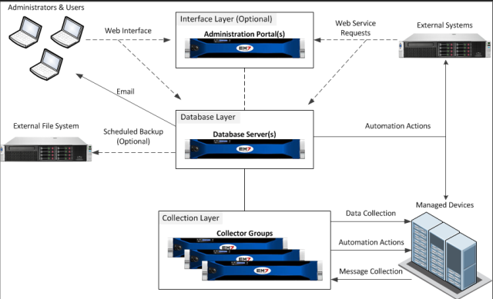
Distributed System
Distributed
Our Implementation
DB Server
API
Web Interface
Data Base
Collector Group
Data Collector
Message Collector

Slide 5
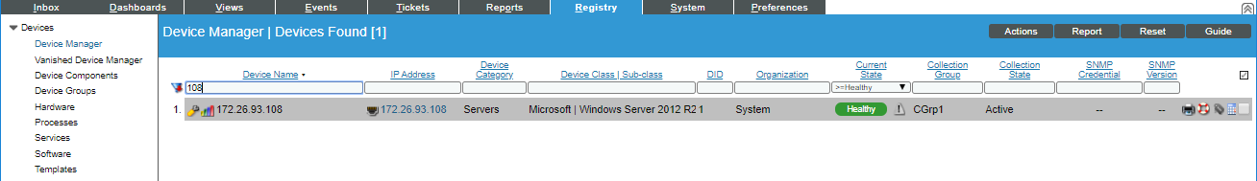
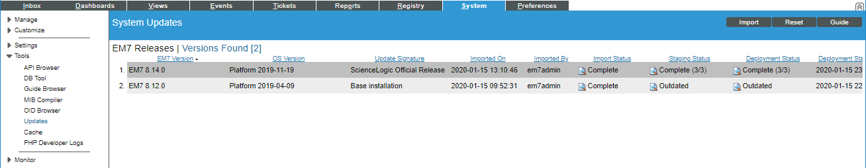
Upgrade 8.12 – 8.14

Slide 6

Review MariaDB
cd /tmp/
wget http://repository.auto.sciencelogic.local:8081/artifactory/script_store/rpm/8-14-0-mariadb-server-package/MariaDB-server-10.1.41-1.el7.centos.x86_64.rpm
sudo systemctl stop em7
sudo systemctl stop mariadb.service
sudo rpm -qa ^MariaDB-*
sudo rpm -Uvh MariaDB-server-10.1.41-1.el7.centos.x86_64.rpm
sudo rpm -qa ^MariaDB-*
sudo systemctl daemon-reload
sudo systemctl start mariadb.service
sudo mysql_upgrade -u root -p
sudo systemctl start em7

Slide 7
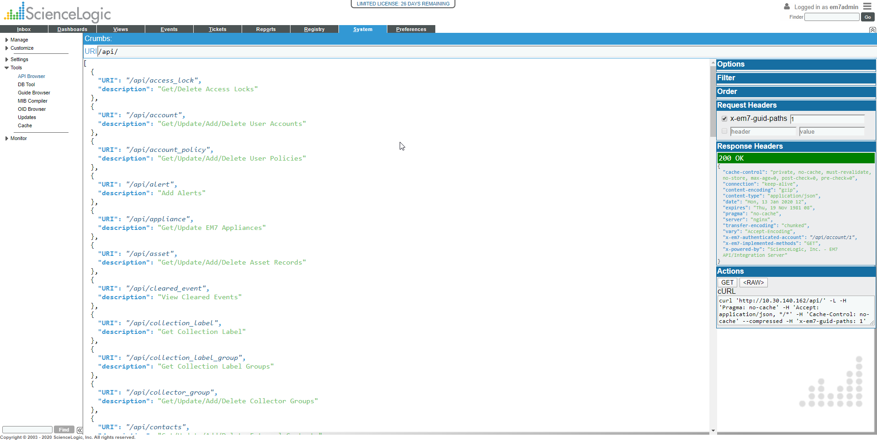
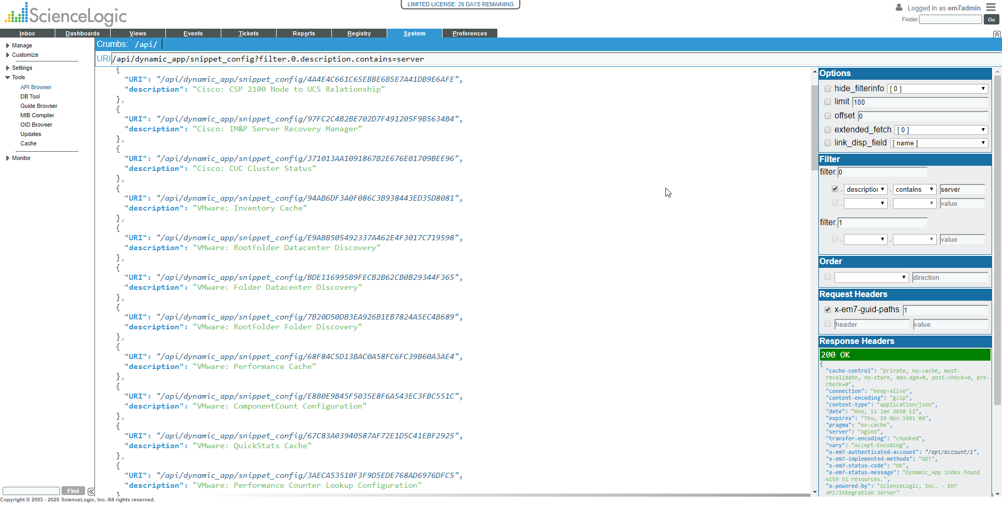
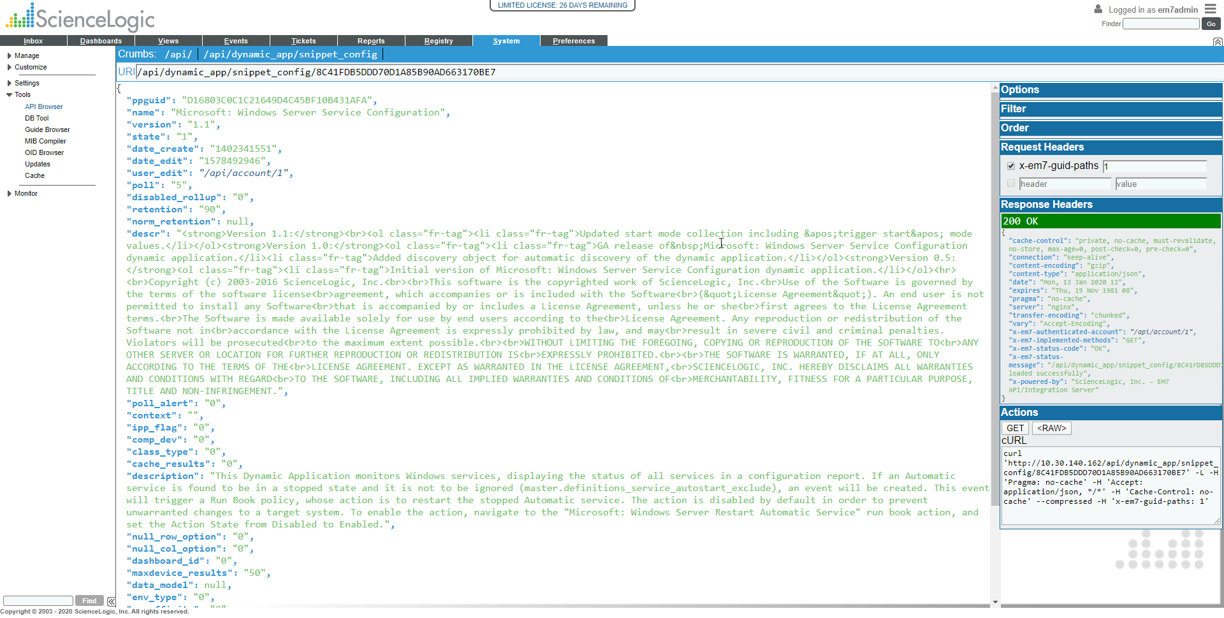
API - Get/Post/Delete

Slide 8
http://Server_ip/api/discovery_session_active
{
"organization":"/api/organization/8",
"discover_non_snmp": "1",
"dhcp_enabled": "0",
"log_all": "1",
"scan_all_ips": null,
"aligned_collector":"/api/appliance/2",
"name":"discoverytestPostManChris",
"interface_inventory_timeout": "600000",
"max_interface_inventory_count": "10000",
"ip_lists": [
{
"start_ip": "10.30.140.167",
"end_ip": "10.30.140.167"
}
],
"credentials": [
"/api/credential/powershell/104"
]
}

Slide 9
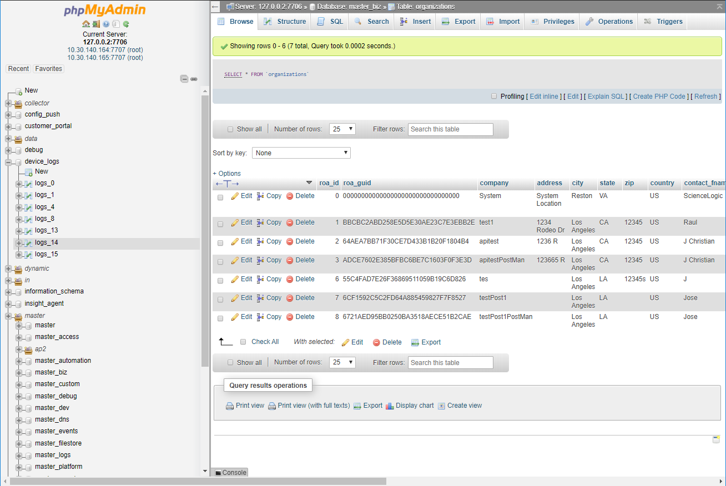
DataBase
Devices_Logs
Master / Master
Dynamic / App / Data /
Master / Master_biz
Master / Master_dev

Slide 10
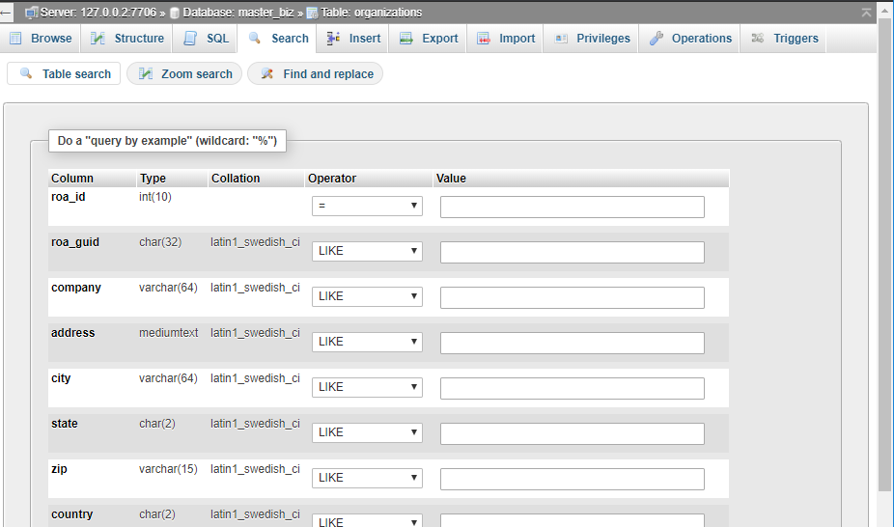
Search

